Slide 1


FAT-GPU: Formal Analysis Techniques for GPU Kernels
Alastair Donaldson
Imperial College London
www.doc.ic.ac.uk/~afd
afd@imperial.ac.uk
Tutorial at HiPEAC 2013, Berlin
Supported by the FP7 project CARP: Correct and Efficient Accelerator Programming
www.carpproject.eu

Slide 2
Aims of this tutorial
Explain two pitfalls of GPU programming: data races and barrier divergence
Demonstrate GPUVerify, a tool for analysing GPU kernels to check for these kinds of defects
Give a taster of the formal verification techniques underlying GPUVerify
Thanks to the GPUVerify contributors: Adam Betts, Nathan Chong, Peter Collingbourne, Jeroen Ketema, Egor Kyshtymov, Shaz Qadeer, Paul Thomson

Slide 3
Graphics processing units (GPUs)
Originally designed to accelerate graphics processing
GPU has many parallel processing elements: graphics operations on sets of pixels are inherently parallel
Early GPUs: limited functionality, tailored specifically towards graphics
Recently GPUs have become more powerful and general purpose. Widely used in parallel programming to accelerate tasks including:
Medical imaging
Financial simulation
Computer vision
Computational fluid dynamics
DNA sequence alignment
…and many more

Slide 4
Graphics processing units (GPUs)
All PEs share global memory
Many PEs
Organised into groups
Local memory
Private memory
Processing element (PE)
Global memory
Local memory
PEs in same group share memory
Local memory

Slide 5
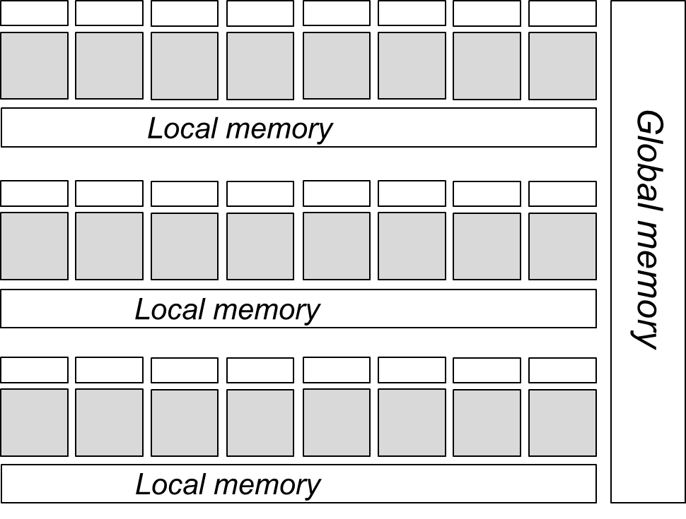
GPU-accelerated systems
Host PC copies data and code into GPU memory
Code is a kernel function which is executed by each PE
GPU
Host
(multicore PC)
Copy data and kernel code
Invoke kernel
Host memory
Copy back results

Slide 6
Data races in GPU kernels
A data race occurs if:
two distinct threads access the same memory location
at least one of the accesses is a write
the accesses are not separated by a barrier synchronisation operation
More on this later

Slide 7
Data races in GPU kernels
Intra-group data race
Inter-group data race
Lead to all kinds of problems!
Almost always accidental and unwanted: data races in GPU kernels are not usually benign

Slide 8
Data races in GPU kernels
We shall look at a technique for analysing whether a GPU kernel can exhibit data races
We shall restrict attention to intra-group data races
Henceforth, let’s assume that all threads are in the same group

Slide 9
GPU kernel example
Indicates that function is the kernel’s entry point
Indicates that A is an array stored in group’s local memory
__kernel void
add_neighbour( ) {
A[tid] = A[tid] + A[tid + offset];
}
__local int* A
, int offset
Read/write data race
Built-in variable which contains thread’s id
Syntax used here is (more or less) OpenCL, an industry standard for multicore computing
All threads execute add_neighbour – host specifies how many threads should run

Slide 10
Illustration of data race
__kernel void
add_neighbour( ) {
A[tid] = A[tid] + A[tid + offset];
}
__local int* A
, int offset
Suppose offset == 1
Thread 0: reads from A[tid + offset], i.e., A[1]
Thread 1: writes to A[tid], i.e., A[1]
Similar data races possible between other pairs of adjacent threads
No guarantee about the order in which these accesses will occur

Slide 11
Illustrating the effects of a data race
Suppose:
offset == 1
A initially contains { 1, 1, 1, 1, 1 }
there are four threads
Let’s see how A evolves for two particular schedules
{ 1, 1, 1, 1, 1 }
{ 1, 1, 1, 1, 1 }
thread 0
thread 3
{ 2, 1, 1, 1, 1 }
{ 1, 1, 1, 2, 1 }
thread 1
thread 2
Completely different results!
{ 2, 2, 1, 1, 1 }
{ 1, 1, 3, 2, 1 }
thread 2
thread 1
{ 2, 2, 2, 1, 1 }
{ 1, 4, 3, 2, 1 }
thread 3
thread 0
{ 2, 2, 2, 2, 1 }
{ 5, 4, 3, 2, 1 }

Slide 12
Barrier synchronisation
barrier()
Used to synchronise threads
When a thread reaches barrier() it waits until all threads reach the barrier
Note: all threads must reach the same barrier – illegal for threads to reach different barriers
When all threads have reached the barrier, the threads can proceed past the barrier
Reads and writes before the barrier are guaranteed to have completed after the barrier

Slide 13
Using barrier to avoid a data race
__kernel void
add_neighbour(__local int* A, int offset) {
int temp = A[tid + offset];
barrier();
A[tid] = A[tid] + temp;
}
Accesss cannot be concurrent

Slide 14
Barrier divergence
Threads must all reach the same syntactic barrier
This is not allowed:
__kernel void foo(...)
{
if(get_local_id() == 0) {
barrier();
} else {
barrier();
}
}

Slide 15
Barrier divergence
In a loop, threads must have performed the same number of iterations on reaching a barrier
This is not allowed:
__kernel void foo() {
int x = (get_local_id() == 0 ? 4 : 1);
int y = (get_local_id() == 0 ? 1 : 4);
for(int i = 0; i < x; i++) {
for(int j = 0; j < y; j++) {
barrier();
}
}
}

Slide 16
GPUVerify: a verifier for GPU kernels
GPUVerify is a tool that analyses the source code of OpenCL and CUDA kernels, to check for:
Intra group data races
Inter group data races
Barrier divergence
Violations of user-specified assertions

Slide 17
GPUVerify architecture
The only magic is here
OpenCL kernel
CUDA kernel
Future work:
C++ AMP
Front-end: build on CLANG/LLVM
Kernel transformation engine
Widely used, very robust
Sequential Boogie program
Candidate loop invariants
Z3 SMT solver
Boogie verification engine
Reusing existing infrastructures makes soundness easier to argue

Slide 18
Demo!
Try it out for yourself:
http://multicore.doc.ic.ac.uk/tools/GPUVerify

Slide 19
Verification technique
We will now look at how GPUVerify works
Essential idea:
Transform massively parallel kernel K into a sequential program P such that correctness of P implies race- and divergence-freedom of K

Slide 20
Focussing data race analysis
All threads are always executing in a region between two barriers:
...
barrier();
barrier();
...
Race may be due to two threads executing statements within the region
Barrier-free code region
We cannot have a race caused by a statement in the region and a statement outside the region
Data race analysis can be localised to focus on regions between barriers

Slide 21
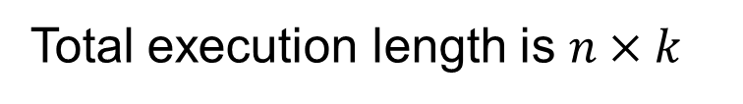
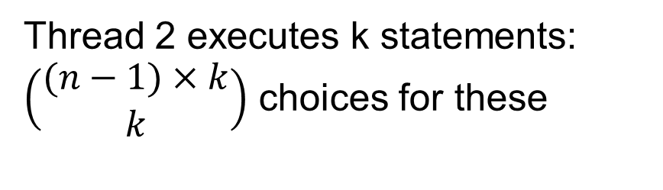
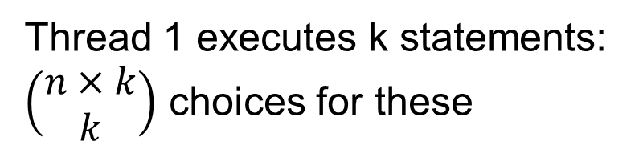
Reducing thread schedules
With n threads, roughly how many possible thread schedules are there between these barriers, assuming each statement is atomic?
barrier();
S₁;
S₂;
...
S_{k}
barrier();
Total execution length is $n×k$
Thread 1 executes k statements: $\left(\begin{matrix}n×k \\ k\end{matrix}\right)$ choices for these
Thread 2 executes k statements:
$\left(\begin{matrix}(n−1)×k \\ k\end{matrix}\right)$ choices for these
etc.
Number of possible schedules: in the order of $n^{k}$

Slide 22
Reducing thread schedules
Do we really need to consider all of these schedules to detect data races?
No: actually is suffices to consider just one schedule, and it can be any schedule

Slide 23
Any schedule will do! For example:
If data race exists it will be detected: abort
barrier(); // A
barrier(); // B
Run thread 0 from A to B
Log all accesses
No data races: chosen schedule equivalent to all others
Run thread 1 from A to B
Log all accesses
Check against thread 0
Run thread 2 from A to B
Log all accesses
Check against threads 0 and 1
Abort on race
. . .
Run thread N-1 from A to B
Log all accesses
Check against threads 0..N-2
Completely avoids reasoning about interleavings!

Slide 24
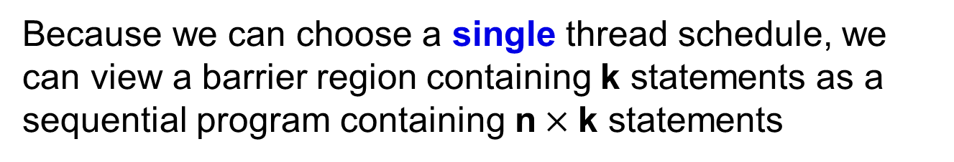
Reducing thread schedules
Because we can choose a single thread schedule, we can view a barrier region containing k statements as a sequential program containing n$×$k statements
This is good: it means we are back in the world of sequential program analysis
But in practice it is quite normal for a GPU kernel to be executed by e.g. 1024 threads
Leads to an intractably large sequential program
Can we do better?

Slide 25
Yes: just two threads will do!
Choose arbitrary i, j $∈$ { 0, 1, …, N-1 } with i ≠ j
barrier(); // A
barrier(); // B
Run thread i from A to B
Log all accesses
Run thread j from A to B
Check all accesses against thread i
Abort on race
If data race exists it will be exposed for some choice of i and j. If we can prove data race freedom for arbitrary i and j then the region must be data race free

Slide 26
Is this sound?
havoc(x) means “set x to an arbitrary value”
barrier(); // A
barrier(); // B
barrier(); // C
No: it is as if only i and j exist, and other threads have no effect!
Solution: make shared state abstract
simple idea: havoc the shared state at each barrier
even simpler: remove shared state completely
Run thread i from A to B
Log all accesses
Run thread j from A to B
Check all accesses against thread i
Abort on race
Run thread i from B to C
Log all accesses
Run thread j from B to C
Check all accesses against thread i
Abort on race

Slide 27
GPUVerify technique and tool
Exploit:
any schedule will do
+
two threads will do
+
shared state abstraction
to compile massively parallel kernel K into sequential program P such that (roughly):
P correct
=>
K free from data races
(no assertion failures)
Next: technical details of how this works

Slide 28
Data race analysis for straight line kernels
Assume kernel has form:
__kernel void foo( <parameters, including __local arrays> ) {
<local variable declarations>
S₁;
S₂;
...
S_{k};
}
where each statement S_{i} has one of the following forms:
x = e
where:
x denotes a local variable
e denotes an expression over local variables
A denotes a __local array parameter
x = A[e]
A[e] = x
barrier()

Slide 29
Data race analysis for straight line kernels
Restricting statements to these forms:
x = e
where:
x denotes a local variable
e denotes an expression over local variables and tid
A denotes a __local array parameter
x = A[e]
A[e] = x
barrier()
means:
Easy to enforce by pre-processing the code
A statement involves at most one load from / stores to local memory
There is no conditional or loop code
We will lift this restriction later

Slide 30
Our aim
We want to translate kernel into sequential program that:
Models execution of two arbitrary threads using some fixed schedule
Detects data races
Treats shared state abstractly
Call original GPU kernel K
Call resulting sequential program P

Slide 31
Introducing two arbitrary threads
K has implicit variable tid which gives the id of a thread
Suppose N is the total number of threads
In P, introduce two global variables:
int tid$1;
int tid$2;
and preconditions:
\requires 0 <= tid$1 && tid$1 < N;
\requires 0 <= tid$2 && tid$2 < N;
\requires tid$1 != tid$2;
Threads must both be in range
Threads must be different
…but otherwise the threads are arbitrary

Slide 32
Race checking instrumentation
For each __local array parameter A in K introduce four global variables:
bool READ_HAS_OCCURRED_A;
bool WRITE_HAS_OCCURRED_A;
int READ_OFFSET_A;
int WRITE_OFFSET_A;
We shall shortly discuss the purpose of these
and four procedures:
void LOG_READ_A(int offset);
void LOG_WRITE_A(int offset);
void CHECK_READ_A(int offset);
void CHECK_WRITE_A(int offset);
We shall shortly discuss the implementation of these
Get rid of parameter A in P

Slide 33
Example illustrating concepts so far:
Form of K
__kernel void foo(__local int* A, __local int* B,
int idx) {
...
}
Form of P
Instrumentation variables for A
Instrumentation variables for B
int tid$1;
int tid$2;
bool READ_HAS_OCCURRED_A; bool READ_HAS_OCCURRED_B;
bool WRITE_HAS_OCCURRED_A; bool WRITE_HAS_OCCURRED_B;
int READ_OFFSET_A; int READ_OFFSET_B;
int WRITE_OFFSET_A; int WRITE_OFFSET_B;
// \requires 0 <= tid$1 && tid$1 < N;
// \requires 0 <= tid$2 && tid$2 < N;
// \requires tid$1 != tid$2;
void foo(int idx) {
...
}
Ids for two threads
Constraining tid$1 and tid$2 to be arbitrary, distinct threads
A and B have gone

Slide 34
Duplicating local variable declarations
Local variable declaration:
duplicated to become:
int x$1;
int x$2;
int x
Reflects fact that each thread has a copy of x
Non-array parameter declaration duplicated similarly.
Non-array parameter x initially assumed to be equal between threads: \requires x$1 == x$2
Notation: for an expression e over local variables and tid we use e$1 to denote e with every occurrence of a variable x replaced with x$1
e$2 is similar
E.g., if e is a + tid - x
e$2 is
a$2 + tid$2 - x$2

Slide 35
Translating statements of K
Encode the statements of K for both threads using round-robin schedule for the two threads being modelled
Stmt
translate(Stmt)
Log location from which first thread reads
x = e;
x$1 = e$1;
x$2 = e$2;
Check read by second thread does not conflict with any prior write by first thread
x = A[e];
LOG_READ_A(e$1);
CHECK_READ_A(e$2);
havoc(x$1);
havoc(x$2);
Over-approximate effect of read by making receiving variables arbitrary
We have removed array A. Thus we over-approximate the effect of reading from A using havoc. We make no assumptions about what A contains

Slide 36
Translating statements of K (continued)
Log location to which first thread writes
Stmt
translate(Stmt)
A[e] = x;
LOG_WRITE_A(e$1);
CHECK_WRITE_A(e$2);
// nothing
Check write by second thread does not conflict with any prior read or write by first thread
barrier();
barrier();
The write itself has no effect in because the array A has been removed
S;
T;
translate(S);
translate(T);
We shall give barrier() a special meaning in translated program

Slide 37
Example so far:
// \requires 0 <= tid$1 && tid$1 < N;
// \requires 0 <= tid$2 && tid$2 < N;
// \requires tid$1 != tid$2;
// \requires idx$1 == idx$2;
void foo(
) {
int x$1; int x$2;
int y$1; int y$2;
LOG_READ_A(tid$1 + idx$1);
CHECK_READ_A(tid$2 + idx$2);
havoc(x$1); havoc(x$2);
LOG_READ_A(tid$1);
CHECK_READ_A(tid$2);
havoc(y$1); havoc(y$2);
LOG_WRITE_A(tid$1);
CHECK_WRITE_A(tid$2);
}
__kernel void
foo(__local int* A,
int idx ) {
int x;
int y;
x = A[tid + idx];
y = A[tid];
A[tid] = x + y;
}
int idx$1; int idx$2

Slide 38
Implementing LOG_READ_A
Global variables READ_HAS_OCCURED_A and READ_OFFSET_A collectively log either nothing, or the offset of a single read from A by the first thread
If READ_HAS_OCCURED_A is false, no read from A by the first thread has been logged. In this case the value of READ_OFFSET_A is meaningless
If READ_HAS_OCCURED_A is true, a read from A by the first thread has been logged, and the offset associated with this read is READ_OFFSET_A
WRITE_HAS_OCCURED_A and WRITE_OFFSET_A are used similarly

Slide 39
Implementing LOG_READ_A
void LOG_READ_A(int offset) {
if(*) {
READ_HAS_OCCURRED_A = true;
READ_OFFSET_A = offset;
}
}
* is an expression that evaluates non-deterministically
Non-deterministically choose whether to
log this read from A, in which case existing values of READ_HAS_OCCURRED_A and READ_OFFSET_A are over-written, or:
Ignore this read from A, in which case READ_HAS_OCCURRED_A and READ_OFFSET_A are left alone

Slide 40
Implementing LOG_WRITE_A
void LOG_WRITE_A(int offset) {
if(*) {
WRITE_HAS_OCCURRED_A = true;
WRITE_OFFSET_A = offset;
}
}
Similar to LOG_READ_A

Slide 41
Implementing CHECK_READ_A
void CHECK_READ_A(int offset) {
assert(WRITE_HAS_OCCURRED_A =>
WRITE_OFFSET_A != offset);
}
A read from A at offset by second thread is OK unless first thread has logged a write to A at this offset
Whether first thread has logged a write to A is determined by WRITE_HAS_OCCURRED_A
If WRITE_HAS_OCCURRED_A is true then WRITE_OFFSET_A records the offset that was written to. This must be different from offset

Slide 42
Implementing CHECK_WRITE_A
void CHECK_WRITE_A(int offset) {
assert(WRITE_HAS_OCCURRED_A =>
WRITE_OFFSET_A != offset);
assert(READ_HAS_OCCURRED_A =>
READ_OFFSET_A != offset);
}
This is similar to CHECK_READ_A, but there is a little more to check:
We must check that write by second thread does not conflict with a write or a read by first thread

Slide 43
Initially, no reads or writes are logged
We specify this via the precondition:
// \requires !READ_HAS_OCCURRED_A
// \requires !WRITE_HAS_OCCURRED_A
for each array A

Slide 44
Example including precondition
// \requires 0 <= tid$1 && tid$1 < N;
// \requires 0 <= tid$2 && tid$2 < N;
// \requires tid$1 != tid$2;
// \requires idx$1 == idx$2;
// \requires !READ_HAS_OCCURRED_A;
// \requires !WRITE_HAS_OCCURRED_A;
void foo(int idx$1, int idx$2) {
int x$1; int x$2;
int y$1; int y$2;
LOG_READ_A(tid$1 + idx$1);
CHECK_READ_A(tid$2 + idx$2);
havoc(x$1); havoc(x$2);
LOG_READ_A(tid$1);
CHECK_READ_A(tid$2);
havoc(y$1); havoc(y$2);
LOG_WRITE_A(tid$1);
CHECK_WRITE_A(tid$2);
}

Slide 45
Example restricted to LOG and CHECK calls
// \requires 0 <= tid$1 && tid$1 < N;
// \requires 0 <= tid$2 && tid$2 < N;
// \requires tid$1 != tid$2;
// \requires idx$1 == idx$2;
// \requires !READ_HAS_OCCURRED_A;
// \requires !WRITE_HAS_OCCURRED_A;
void foo(int idx$1, int idx$2) {
LOG_READ_A(tid$1 + idx$1);
CHECK_READ_A(tid$2 + idx$2);
LOG_READ_A(tid$1);
CHECK_READ_A(tid$2);
LOG_WRITE_A(tid$1);
CHECK_WRITE_A(tid$2);
}
What happens to x and y is irrelevant in this example. Let’s omit these details to really focus on what the LOG and CHECK calls are doing

Slide 46
Inlining all log and check calls
// other preconditions same as before
// \requires !READ_HAS_OCCURRED_A;
// \requires !WRITE_HAS_OCCURRED_A;
void foo(int idx$1, int idx$2) {
if(*) { READ_HAS_OCCURRED_A = true;
READ_OFFSET_A = tid$1 + idx$1; }
assert(WRITE_HAS_OCCURRED_A => WRITE_OFFSET_A != tid$2 + idx$2);
if(*) { READ_HAS_OCCURRED_A = true;
READ_OFFSET_A = tid$1; }
assert(WRITE_HAS_OCCURRED_A => WRITE_OFFSET_A != tid$2);
if(*) { WRITE_HAS_OCCURRED_A = true;
WRITE_OFFSET_A = tid$1; }
assert(WRITE_HAS_OCCURRED_A => WRITE_OFFSET_A != tid$2);
assert(READ_HAS_OCCURRED_A => READ_OFFSET_A != tid$2);
}
// LOG_READ_A(tid$1 + idx$1);
// CHECK_READ_A(tid$2 + idx$2);
// LOG_READ_A(tid$1);
// CHECK_READ_A(tid$2);
// LOG_WRITE_A(tid$1);
// CHECK_WRITE_A(tid$2);
The non-determinism ensures that some program execution checks every pair of potentially racing operations

Slide 47
Checking read from A[tid$1] against write to A[tid$2]
// other preconditions same as before
// \requires !READ_HAS_OCCURRED_A;
// \requires !WRITE_HAS_OCCURRED_A;
void foo(int idx$1, int idx$2) {
if(*) { READ_HAS_OCCURRED_A = true;
READ_OFFSET_A = tid$1 + idx$1; }
assert(WRITE_HAS_OCCURRED_A => WRITE_OFFSET_A != tid$2 + idx$2);
if(*) { READ_HAS_OCCURRED_A = true;
READ_OFFSET_A = tid$1; }
assert(WRITE_HAS_OCCURRED_A => WRITE_OFFSET_A != tid$2);
if(*) { WRITE_HAS_OCCURRED_A = true;
WRITE_OFFSET_A = tid$1; }
assert(WRITE_HAS_OCCURRED_A => WRITE_OFFSET_A != tid$2);
assert(READ_HAS_OCCURRED_A => READ_OFFSET_A != tid$2);
}
Possible race checked by choosing to log the read, then executing the assert. In this case there is no race

Slide 48
Checking read from A[tid$1 + idx$1] against write to A[tid$2]
Possible race checked similarly – in this case a potential race is detected
// other preconditions same as before
// \requires !READ_HAS_OCCURRED_A;
// \requires !WRITE_HAS_OCCURRED_A;
void foo(int idx$1, int idx$2) {
if(*) { READ_HAS_OCCURRED_A = true;
READ_OFFSET_A = tid$1 + idx$1; }
assert(WRITE_HAS_OCCURRED_A => WRITE_OFFSET_A != tid$2 + idx$2);
if(*) { READ_HAS_OCCURRED_A = true;
READ_OFFSET_A = tid$1; }
assert(WRITE_HAS_OCCURRED_A => WRITE_OFFSET_A != tid$2);
if(*) { WRITE_HAS_OCCURRED_A = true;
WRITE_OFFSET_A = tid$1; }
assert(WRITE_HAS_OCCURRED_A => WRITE_OFFSET_A != tid$2);
assert(READ_HAS_OCCURRED_A => READ_OFFSET_A != tid$2);
}

Slide 49
Implementing barrier()
void barrier() {
assume(!READ_HAS_OCCURRED_A);
assume(!WRITE_HAS_OCCURRED_A);
// Do this for every array
}
The if(*) { … } construction in LOG_READ and LOG_WRITE means that there is one path along which nothing was logged
barrier() has the effect of killing all paths except this one

Slide 50
Summary so far
For each array parameter A:
Introduce instrumentation variables to log reads from and writes to A
Generate procedures to log and check reads and writes, using non-determinism to consider all possibilities
Remove array parameter, and model reads from A using non-determinism
For statements in kernel K: generate corresponding statements in sequential program P
Interleave two arbitrary threads using round-robin schedule
Conditionals and loops are handled using predication (coming up)

Slide 51
Worked example
Satisfiability Modulo Theories (SMT) solving
Boogie intermediate language for verification
Translating GPU kernel verification into Boogie

Slide 52
Handling loops and conditionals
Use predicated execution
Essence of predicated execution: flatten conditional code into straight line code
Example:
if(x < 100) {
x = x + 1;
} else {
y = y + 1;
}
P = (x < 100);
Q = !(x < 100);
x = (P ? x + 1 : x);
y = (Q ? y + 1 : y);
make predicated

Slide 53
Handling loops and conditionals
Apply predication to kernel so that at every execution point there is a predicate determining whether each of the threads are enabled
Add parameters to LOG_READ/WRITE_A and CHECK_READ/WRITE_A recording whether first or second thread, respectively, is enabled

Slide 54
Translating statements with predicate
We revise the encoding rules to incorporate a predicate of execution for each thread; these are initially true
Stmt
translate(Stmt, P)
x = e;
x$1 = P$1 ? e$1 : x$1;
x$2 = P$2 ? e$2 : x$2;
LOG and CHECK calls take predicate as parameter
x = A[e];
LOG_READ_A(P$1, e$1);
CHECK_READ_A(P$2, e$2);
x$1 = P$1 ? * : x$1;
x$2 = P$2 ? * : x$2;
We only havoc x$1 and x$2 if P$1 and P$2, respectively, are true
A[e] = x;
LOG_WRITE_A(P$1, e$1);
CHECK_WRITE_A(P$2, e$2);
LOG and CHECK calls take predicate as parameter

Slide 55
Translating statements with predicates
The predicates come from conditionals and loops
Stmt
translate(Stmt, P)
Q and R are fresh
if(e) {
S;
} else {
T;
}
Q$1 = P$1 && e$1;
Q$2 = P$2 && e$2;
R$1 = P$1 && !e$1;
R$2 = P$2 && !e$2;
translate(S, Q);
translate(T, R);
Code for both threads becomes predicated
Threads compute loop guard into predicate
while(e) {
S;
}
Q$1 = P$1 && e$1;
Q$2 = P$2 && e$2;
while(Q$1 || Q$2) {
translate(S, Q);
Q$1 = Q$1 && e$1;
Q$2 = Q$2 && e$2;
}
Loop until both threads are done
Translate loop body using loop predicate
Re-evaluate loop guard

Slide 56
Translating statements with predicates
Stmt
translate(Stmt, P)
S;
T;
translate(S, P);
translate(T, P);
barrier();
barrier(P$1, P$2);
barrier now takes parameters determining whether the threads are enabled

Slide 57
Implementing predicated LOG_READ_A
Records whether first thread is enabled
void LOG_READ_A(bool enabled, int offset) {
if(enabled) {
if(*) {
READ_HAS_OCCURRED_A = true;
READ_OFFSET_A = offset;
}
}
}
If first thread is not enabled it does not execute the read, thus there is nothing to log
LOG_WRITE_A is similar

Slide 58
Implementing predicated CHECK_WRITE_A
Records whether second thread is enabled
void CHECK_WRITE_A(bool enabled, int offset) {
assert(enabled && WRITE_HAS_OCCURRED_A =>
WRITE_OFFSET_A != offset);
assert(enabled && READ_HAS_OCCURRED_A =>
READ_OFFSET_A != offset);
}
If second thread is not enabled it did not execute the write, thus there is nothing to check
CHECK_READ_A is similar

Slide 59
Implementing barrier with predicates
void barrier(bool enabled$1, bool enabled$2) {
assert(enabled$1 == enabled$2);
if(!enabled$1) {
return;
}
// As before:
assume(!READ_HAS_OCCURRED_A);
assume(!WRITE_HAS_OCCURRED_A);
// Do this for every array
}
The threads must agree on whether they are enabled – otherwise we have barrier divergence
barrier does nothing if the threads are not enabled
Otherwise it behaves as before

Slide 60
Worked example with conditionals

Slide 61
Find out more
Check out: GPUVerify:
http://multicore.doc.ic.ac.uk/tools/GPUVerify
My web page:
http://www.doc.ic.ac.uk/~afd
My group’s page:
http://multicore.doc.ic.ac.uk
If you would like to talk about doing a PhD at Imperial, please email me: afd@imperial.ac.uk

Slide 62
Bibliography
From my group:
A. Betts, N. Chong, A. Donaldson, S. Qadeer, P. Thomson, GPUVerify, a Verifier for GPU Kernels, OOPSLA 2012
P. Collingbourne, A. Donaldson, J. Ketema, S. Qadeer, Interleaving and Lock-Step Semantics for Analysis and Verification of GPU Kernels, ESOP 2013
University of Utah:
G. Li, G. Gopalakrishnan, Scalable SMT-Based Verification of GPU Kernel Functions, FSE 2010
G. Li, P. Li, G. Sawaya, G. Gopalakrishnan, I. Ghosh, S. Rajan, GKLEE: Concolic Verification and Test Generation for GPUs, PPoPP 2012
University of California, San Diego
A. Leung, M. Gupta, Y. Agarwal, R. Gupta, R. Jhala, S. Lerner, Verifying GPU Kernels by Test Amplification. PLDI 2012

Slide 63
Thank you for your attention!

